Slide 1
SMART HOTEL

Slide 2
Problem
In Hotels there can be situations where delayed work and manual errors can lead to customer dissatisfaction
This might effect the revenue of the hotel if the mismanagement continues.
Also customer cannot directly contact the manager regarding any issues. This creates a dissatisfaction amongst the customer.
Customer doesn’t have the option to select rooms on the basis of his preference. He has to stay in the allotted room.

Slide 3
Proposed Solution
Smart Hotel is an effort to increase the efficiency of a Hotel by minimizing manual labor
Customer requests will be taken in the priority and it’ll help to build a better relation with the client.
All the roles in this project have the access to their field of work and they can provide better service as it’s a managed application.

Slide 4
Key Roles
Manager Role- He is the admin for a particular hotel who adds all employee there.
Cook- He cooks food and can take up the order he want to make.
Attendant- He fills in the room essential things like water etc.
Cleaner- He is assigned the role of cleaning the room as requested by customer.
Security- Takes care of the building and also brings the car for his ride when he requests.
Customer- He is the person who gets all the luxury and for whom the whole works.

Slide 5
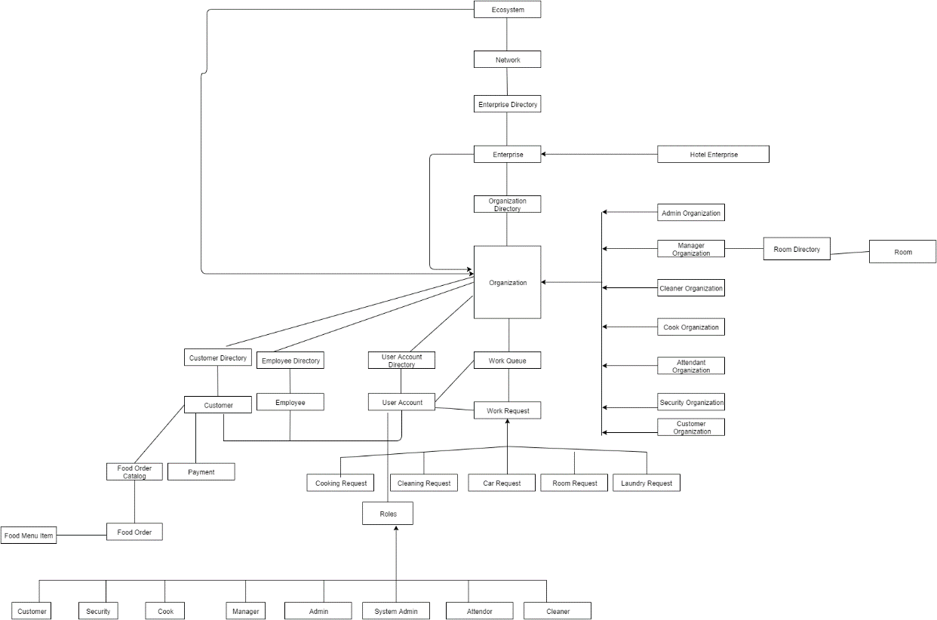
Object Model

Slide 6
Key Features
There is no Receptionist. So customer comes in to the hotel, enters his information in the desktop lined up in the login
In case of Fire in the hotel, as soon as heat level gets high Manager gets SMS alert.
Customer can order his favorite food from his room or Hotel. And cook directly takes the order and makes it.
This is a prototype of a fully functioning Hotel.
Customer has the liberty to choose the room type he wants like pool view etc. Also he can select the room in his budget as well. This increases his flexibility.
Customer has all options to request for Cleaning, Laundry and Food from the room.

Slide 7
Extra Features
If the customer wants to go out, he can just request the security official to get the car. As the car arrives, he’ll get an SMS alert.
Customer adds his google wallet or apple pay details in the beginning. After that he doesn’t need to bother about this hassle and according to the service taken he’ll be charged automatically.
If customer is dissatisfied with any service or in case of other emergencies, he can directly contact the Hotel Manager. He can pitch in and resolve the issue.

Slide 8
Use Cases
Customer signs up from the lobby desktop and adds all his information including paying.
He has numerous choice of food from which he can select and if he wants to customize, he can write a message for that.
Cook will receive that request and processes it.
He has choice of Rooms from the list given, he can select according to his preference and budget for eg Pool View etc.
He gets all facilities like cleaning where cleaner is sent the request and cleaner comes and does it as told by customer.

Slide 9
Use Cases-(cntd…)
Similar is the case with laundry service as well
Also in case of any emergency, he can directly contact the Hotel manager.
He also can view his payment details with the detailed invoice.
Also in case of Fire, the sensors will give an alert to manager.

Slide 10
Thank You…

